Slide 1
The Effects of Salt on Tadpoles
A student science project

Slide 2
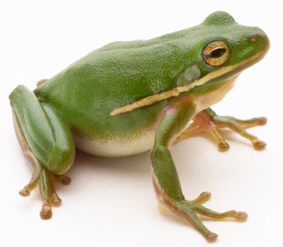
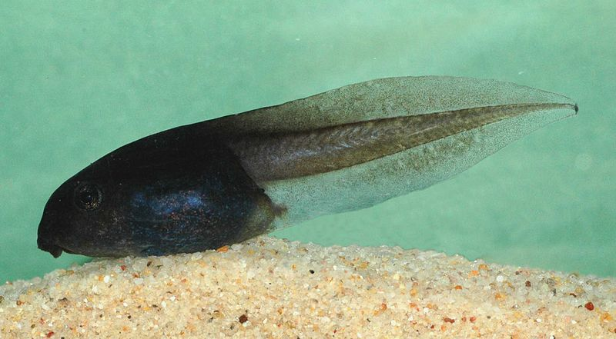
What are Tadpoles?
Frogs have a complex life cycle with several progressions.
Egg → Tadpole → Froglet → Adult
Tadpoles are juvenile frogs that emerge from the egg stage.
Characteristics of this stage:
Live in water – have specialized tail for swimming
Eat underwater plants like algae or periphyton
Breathe through gills like fish
http://commons.wikimedia.org/wiki/File:Litoria_littlejohni_tadpole.jpg
http://science.howstuffworks.com/zoology/reptiles-amphibians/frog.htm
Notes:
Background information on study subject. All very straight forward – if you wish to focus more heavily on the life cycle of the frog, there are a few videos on my website that are appropriate for classes. (http://albeckerm09.wix.com/mollyalbecker )

Slide 3
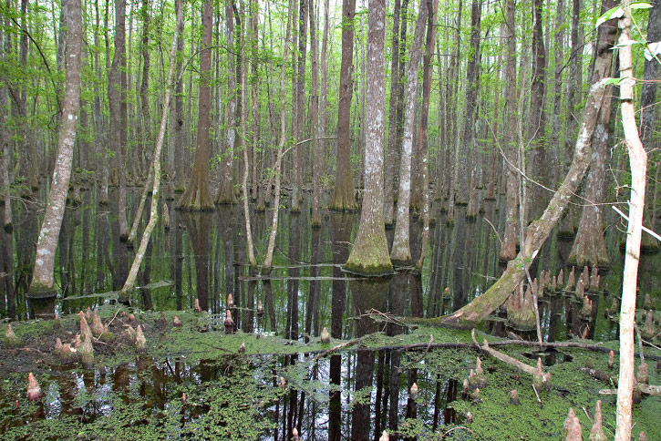
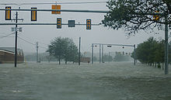
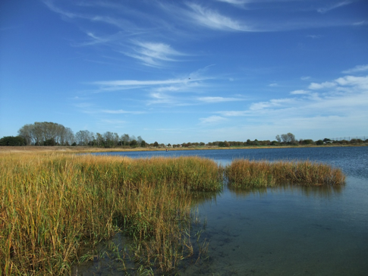
Where do tadpoles live?
In freshwater wetlands around the world
Live in bogs, swamps, lakes, ponds, even roadside ditches!
In coastal wetlands, salt can contaminate freshwater
Storm surges, intrusion from aquifers, flooding events
http://www.greglasley.net/nonBirds/cypresswamp.html
http://en.wikipedia.org/wiki/Hurricane_Isabel
http://www.sheepsheadbites.com/tag/marine-park-salt-marsh/
Notes:
Pictures are two examples of wetlands. The third pic on the right is the flooding that resulted from Hurricane Isabel in 2003.
Storm surges: very large waves from the strong winds that overwash marshes and wetlands
Intrusion from aquifers: When the water in the underground water table becomes contaminated with saltwater and percolates up to contaminate surface waters.
Flooding Events: When salty or brackish waters rise and overwash wetlands, depositing salt.

Slide 4
Why should we care about saltwater into freshwater habitats??
When solute concentrations are high OUTSIDE the cells, water will passively flow out of the cell, shriveling the cell like a raisin.
Why? Because there is less water outside the cell and therefore the water will naturally flow from high to low concentrations.
This is a hypertonic solution
When there are more solutes INSIDE the cell, water will passively flow into the cell, causing the cell to swell up.
Why? Because there is less water inside the cell and therefore the water will naturally flow from high to low concentrations.
This is a hypotonic solution.
Notes:
Salts are a solute in the water. They are dissolved into the water which increases the solute concentration in the water. When cells with permeable membranes are submerged in that, there is more water inside the cell than outside. Therefore, since water “wants” to flow from high to low concentrations, it will naturally flow out of the cell. This will cause the cells to shrink and dehydrate.
Similarly, when cells are submerged in pure water (i.e. very few solutes), there are more solutes inside the cell than outside. Therefore, water “wants” to flow from high to low concentration and will naturally flow INTO the cell. This can cause cells to swell and sometimes burst.
A memory device for students: Go backwards from the term: hypOtonic. Emphasize the O. Cells swell up into O’s. If they are swelling, water is flowing in, if water is flowing in, there was less water in there. If there was less water, there were more solutes taking up all the space!

Slide 5
More solutes outside the cell
Compared to the inside
Iso = same
Same concentrations
More solutes inside the cell
Compared to the outside
Saltwater!
Freshwater!
Above teaching aide: http://0.tqn.com/d/chemistry/1/0/p/U/1/osmotic-pressure-blood-cells.jpg

Slide 6
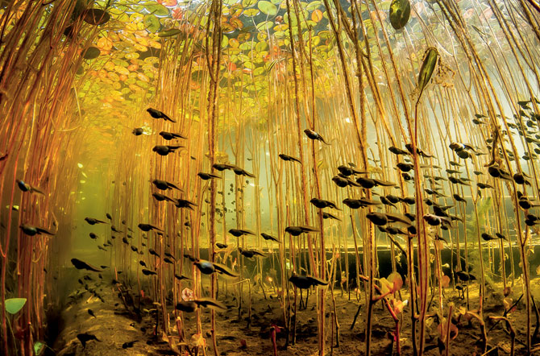
Tadpoles in Saltwater
Tadpoles are HYPERtonic to saltwater – and they can’t leave the water either!
Cells will shrink, tadpoles will dehydrate, and cannot survive for long.
http://ngm.nationalgeographic.com/wallpaper/2013/april-ngm-wallpaper#/11-0413-black-cloud-tadpoles-water-lilies-670.jpg
Notes:
Since there are more solutes outside the tadpole than inside the tadpole in saltwater, the water inside the tadpole will flow through the cell membranes out of the tadpole.

Slide 7
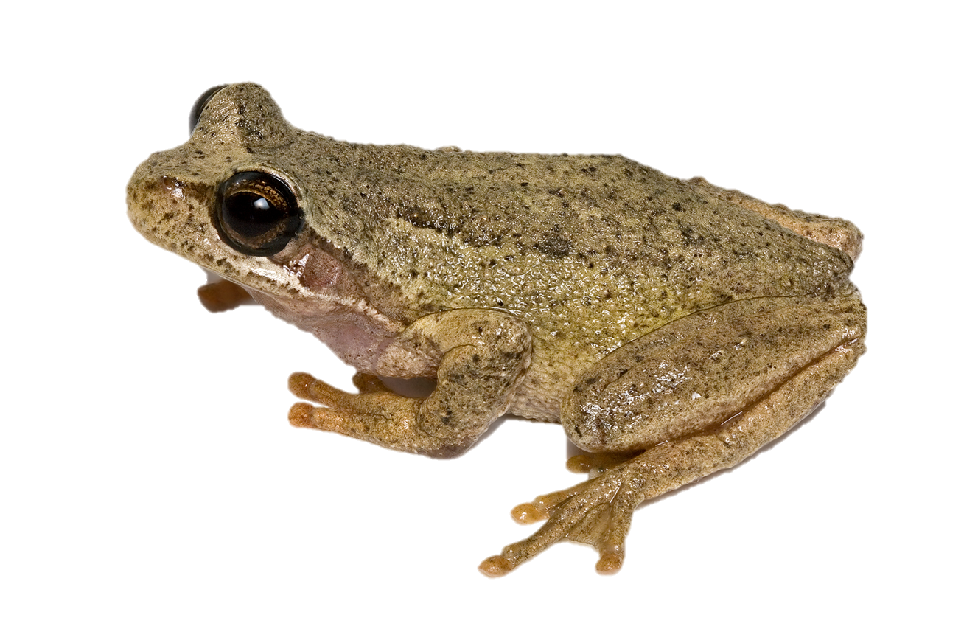
UNLESS…
Tadpoles will die quickly in saltwater unless they have an adaptation to maintain homeostasis
Homeostasis: maintaining constant internal conditions
http://upload.wikimedia.org/wikipedia/commons/b/ba/Brown_Tree_Frog_2.jpg

Slide 8
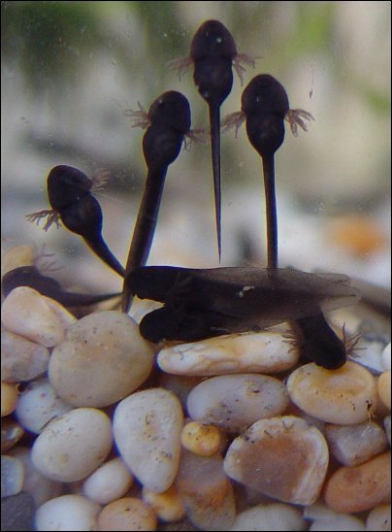
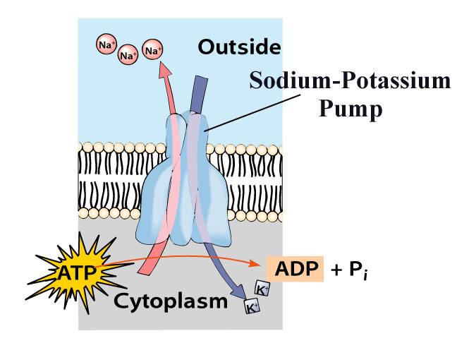
How do tadpoles maintain water balance?
Tadpoles breathe through gills
Gills also excrete excess salts
How? Sodium-potassium pumps!
http://iws.collin.edu/biopage/faculty/mcculloch/1406/outlines/chapter%208/chap08.html
http://www.erodent.co.uk/gardenpond/march2002.htm
Notes:
Those appendages on the tadpoles look like fins like fish, but they are actually external gills
Go to the next slide for an explanation on the Sodium Potassium Pump.

Slide 9
Sodium-Potassium Pumps
These pumps are located in the cells membrane of the gills
They actively (i.e., use energy) pump the extra sodium out of the cell, thereby allowing the tadpole to maintain osmotic balance
This animation shows how sodium potassium pumps work:
Click here
http://iws.collin.edu/biopage/faculty/mcculloch/1406/outlines/chapter%208/chap08.html
Notes:
These pumps are made of proteins. Proteins are built by amino acid sequences that are coded by DNA.
In case the link breaks, here it is again: http://highered.mcgraw-hill.com/sites/0072495855/student_view0/chapter2/animation__how_the_sodium_potassium_pump_works.html

Slide 10
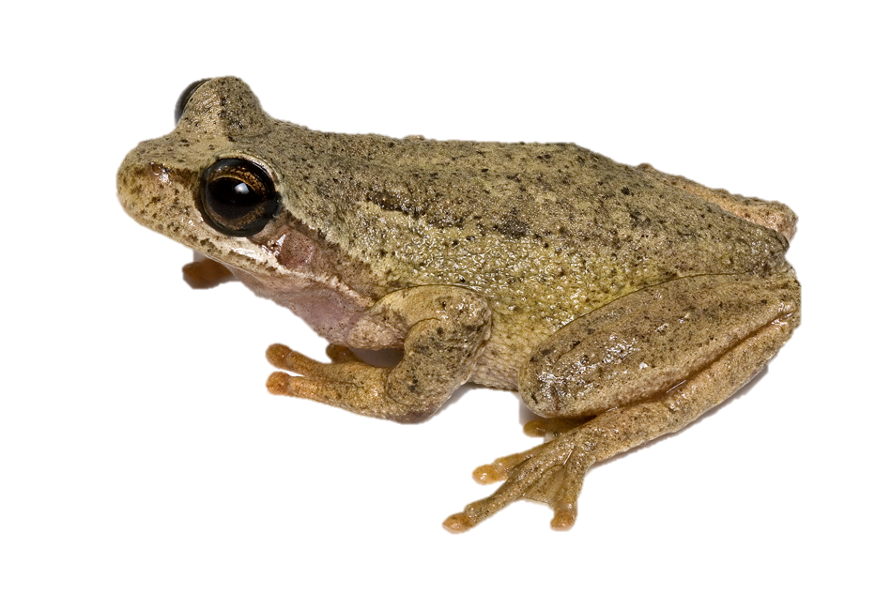
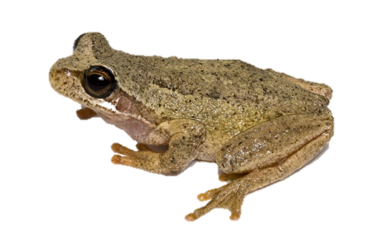
But there’s a catch…
Tadpoles spend their time foraging for food to find energy to grow.
Getting lots of food means that tadpoles can metamorphose faster and avoid a drying pond, aquatic predators, and food shortages.
When tadpoles have to divert the energy into energy to run the sodium-potassium pumps (rather than using it to grow), they grow slower and are smaller at metamorphosis.
Notes:
Emphasize how it is a trade-off between growing to a big size (which is advantageous for mating and avoiding gape-limited predators) and surviving in salty conditions.

Slide 11
Let’s do a Science Project!

Slide 12
Research Question
Do tadpoles that live in salty water grow more slowly compared to tadpoles in freshwater?
Hypothesis: proposed explanation made on the basis of limited knowledge as a starting point for further investigation
Using your knowledge about the tradeoff between energy for growth and energy to run the sodium-potassium pumps:
What is your hypothesis for this question?
My hypothesis is that __________________________________.
Notes:
Have students write down their hypotheses so that they can refer to them again later.

Slide 13
Experimental Design
Experimental Design: process to gather information (data) to help answer our question.
For our experimental design, we need two treatments.
Treatment one: Tadpoles in saltwater
Treatment two: Tadpoles in freshwater
Except for the salinity of the water, we should make every effort to make these treatments identical. Why?
Notes:
Why should we make these treatments identical?
If they are different, can we be sure that the differences we observe are due to the saltwater/freshwater difference or because of something else? By keeping them the same, we can isolate the water as the mechanism that is responsible for the changes we observe.

Slide 14
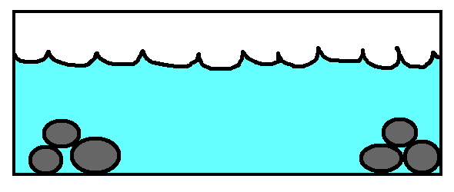
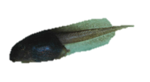
Our Experimental Design:
Treatment 1:
½ Tadpoles in Tank 1
1 tsp. of salt mixed in
Treatment 2:
½ Tadpoles in Tank 2
No salt mixed in
Notes:
1 tsp of salt in 1 gallon of water should make it stressful without killing the tadpoles (we don’t want to scar any students).
Tadpoles can tolerate some salt, but they can’t live in full-strength seawater.
If you change the water, be sure to remember to add salt again!

Slide 15
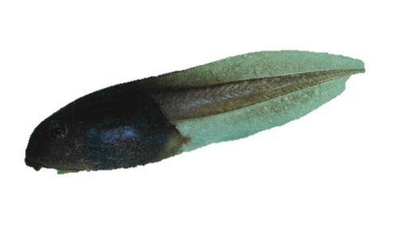
Methods
Now that we have the two tanks set up, we can sit and observe the tadpoles as they grow and develop!
It is important to feed the tadpoles, but make sure you feed the same amount to each tank.
Record observations periodically.
We will collect our data once the tadpoles begin to metamorphose!

Slide 16
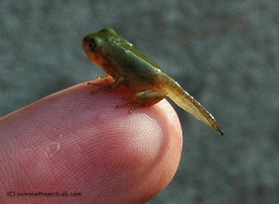
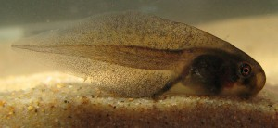
Data Collection
Tadpoles will sprout legs before they metamorphose.
They will sprout their back legs first, and will only sprout their front legs right when they are ready to emerge from the water.
After sprouting all 4 legs, tadpoles will climb out of the water and will cling to the sides of the tank.
On the data sheet, record how many tadpoles emerge and how many days have passed since hatching until they have all left the water.
After you have recorded the individuals that have left the water, scoop them out and place them in a separate container (lined with a moist paper towel – but not fully in water or they will drown!)
http://frogsaregreen.org/tag/froglet/
Notes:
If you choose to weigh the tadpoles, they will need to be weighed immediately after emerging for the best results. Again, this might be tricky because they are very small, fragile, and jumpy. But power to you if you can do it!

Slide 17
Results!
To determine if there are any differences in the time to metamorphosis, lets average the results from each treatment and then plot our data in a graph!
= Freshwater
= Saltwater
Days passed until metamorphosis
Number that metamorphose
Saltwater
Freshwater
Day 45
Day 46
Day 47
Day 48
Day 49
Notes:
A bar graph is the simpler and easier approach, however, If the averages are too similar, you can also do a scatter plot where the X-axis is “day number” and the Y-axis is the number that emerged that day. You should get two different lines for each treatment and the effects might be a little clearer. The above are example graphs and not based on any data.

Slide 18
Conclusions
What patterns did your data reveal from the experiment?
Did the results support or refute your original hypothesis?
What might be some reasons behind the different observations between the treatments?

Slide 19
Lab Report
This lab report will be about this experiment. It is different from an essay because it is divided into sections.
Section 1: Introduction
Use this section to cover the background of the topic. You may want to cover frog life cycles, how tadpoles handle salt stress, and the tradeoffs associated with osmoregulation.
Include information that you gather from outside sources
Be sure to cite your works!
Important! Include your hypothesis in this section.

Slide 20
Lab Report
Section 2: Methods and Materials.
The purpose of this section is to outline our experimental design. It should be detailed enough for another student to run the same experiment from the information in your report.
Diagrams and drawings are always helpful!

Slide 21
Lab Report
Section 3: Results!
This section is where you put your data. Since we made graphs, the graphs will go in this section.
Be sure to label your axes, include a legend, and put a figure caption below the graph so that people reading your report understand the data.
Important note: Do no discuss what your results mean in this section. All you want in the results section are the data and graphics.

Slide 22
Lab Report
Section 4: Conclusion/Discussion
This is the section where you discuss what your results mean.
Discuss whether your results supported your original hypothesis
Why do you think they supported your hypothesis? Why not?
What are some explanations for your observed data?
Can you tie in natural selection into these results?
How might it be adaptive to tolerate salty environments?

Slide 23
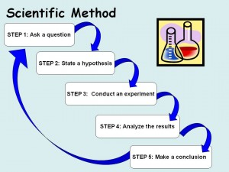
Congratulations!
You have just gone through the scientific method just like a real life scientist!
http://science-fair-coach.com/scientific-method/

