Slide 1
Frogs

Slide 2
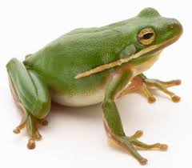
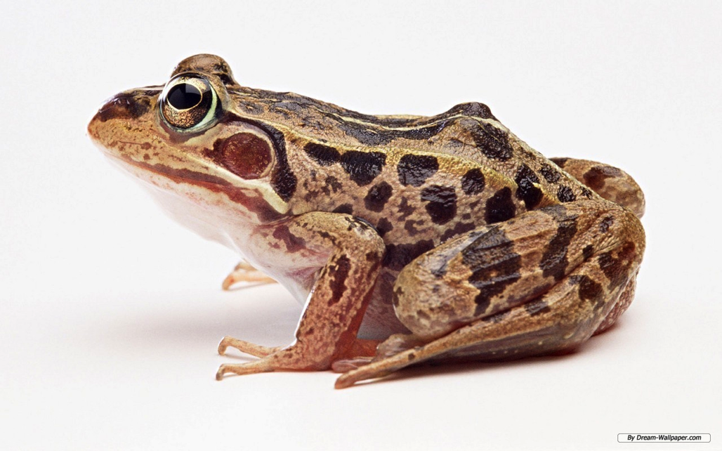
What are frogs?
Frogs are amphibians
Amphibians live both in the water and on land
They breathe through wet, delicate skin
Notes:
They are called amphibians because they live a double life, part of their life spent in water, part of their life spent on land! You’ll learn more about that life cycle later.
One of the most important things about amphibians is their skin. Believe it or not, they do not breathe through their mouths like you and me! They can actually absorb the oxygen they need to breathe through their skin. Therefore frog skin is very fragile and delicate and important for their survival. Do you breathe through your skin or through your mouths?

Slide 3
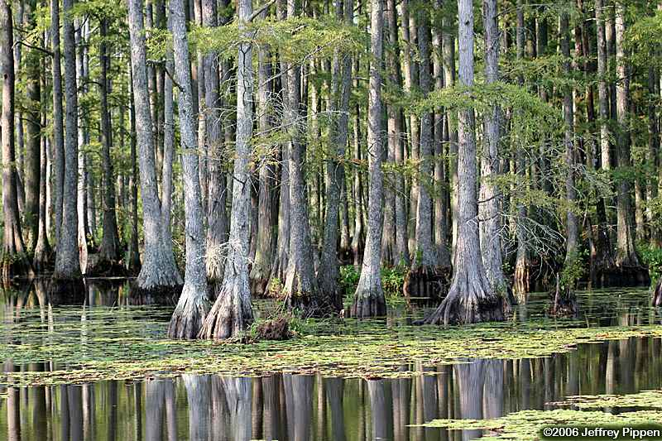
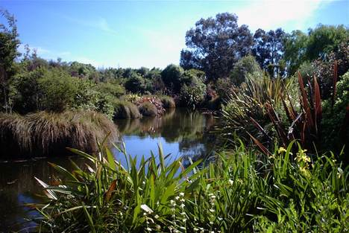
Where do frogs live?
Frogs live close to water
They live around swamps, ponds, and lakes
In water, frogs can find food and keep moist
Notes:
Frogs need to stay near water. They need to stay moist because of their skin. If their skin dries out, they will not be able to breathe as well. Therefore, they stay near water so that they can wet their skin if they need to!

Slide 4
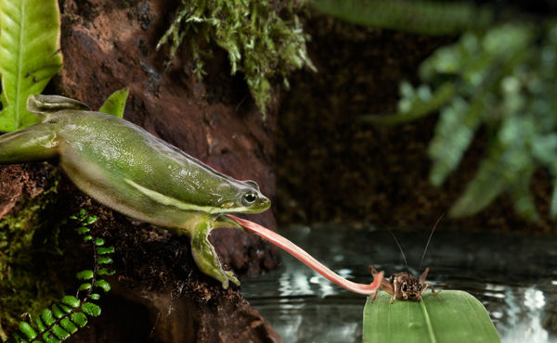
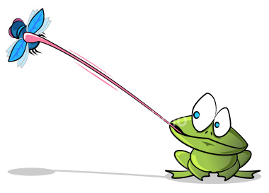
What do frogs eat?
Frogs are carnivores so they eat things like insects, crickets, flies, or worms.
Frogs use a long, sticky tongue to catch their food!
Notes:
Adult Frogs are carnivorous. This means they do not eat any plants, but only other animals. This might sound scary, but they are actually very helpful to humans because they eat the bugs and creepy crawlies that we don’t like, like flies and worms.
Frogs have a very neat method of catching their food! They will stay very still and wait for a bug to come close. Then they will very quickly open their mouths and shoot out their long tongue! The tips of their tongues are very sticky. If the frog is accurate and hits the bug, the bug will stick to the tongue as the frog pulls its tongue back into its mouth, meal and all!

Slide 5
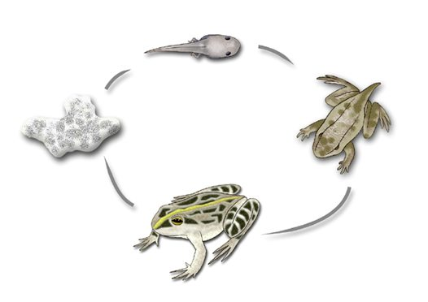
Frog Life Cycle
Frogs have a complex life cycle
Frogs have very different appearances and habitats as they develop
The stages are egg, tadpole, froglet, frog.
Notes:
Do grown ups look like babies? No, they don’t. People go through changes as they grow older. Frogs change as they grow older too. We are going to learn all about the life cycle that frogs undergo as they grow older. The stages that we will learn about are the egg stage, the tadpole stage, the froglet stage, and the adult stage.

Slide 6
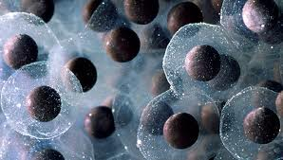
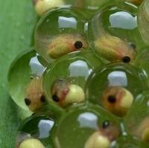
Frog Life Cycle: Egg Stage
Frog females lay eggs, and that is where new frogs begin their lives.
Eggs are laid in water
They are surrounded by a jelly-like substance that protects them from injury
Notes:
Usually frogs lay eggs on wet and warm nights during the spring and summer. Have you ever heard a lot of frog calls during summer nights? Those are the frogs getting ready to lay their eggs.
Because they would dry out if they were laid on land, frog parents lay the eggs in water.
The frog parents do not stay around, but leave and let the young develop on their own.
The eggs have a special jelly layer that helps protect them.

Slide 7
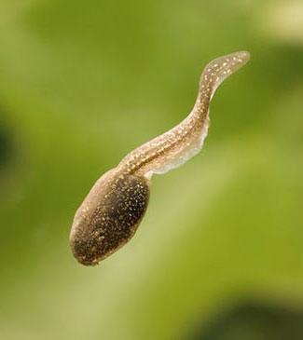
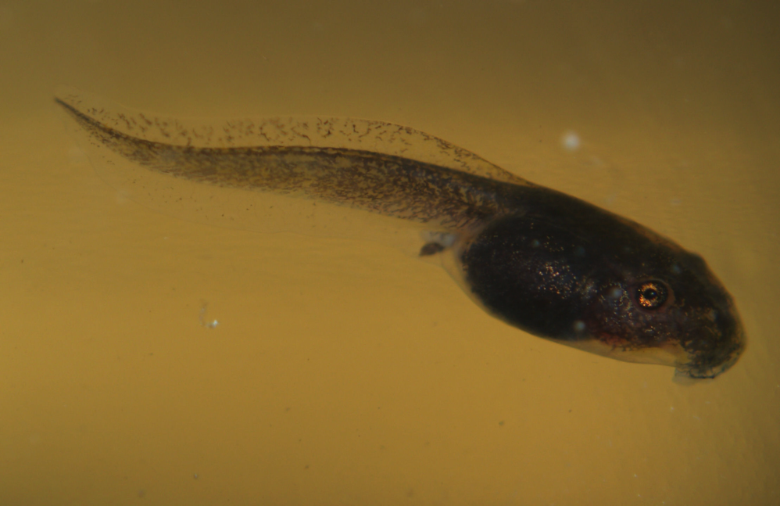
Frog Life Cycle: Tadpole
Tadpoles hatch out of the eggs
Tadpoles live in water and have special tails to help them swim
Tadpoles eat plants to grow
To breathe, they use gills like fish
Notes:
The developing frogs are called Tadpoles after they hatch out of the eggs. Tadpoles spend their time swimming around in the water to find food to help them grow and survive.
To grow and survive, tadpoles eat plants like algae and other underwater plants
During the tadpole stage, they have long tails that act like paddles. This tail helps them to swim quickly to find food and escape from danger quickly!
While tadpoles, they have no arms or legs, they are just a body and legs.

Slide 8
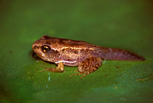
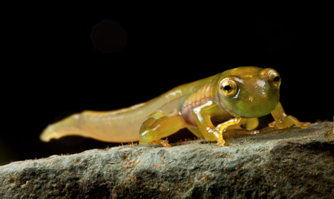
Frog Life Cycle: Froglet
After they sprout their legs, the tadpoles become froglets
They leave the water
Froglets lose gills and breathe air
The tail shrinks and eventually disappears!
http://www.ezeewebs.com/
http://www.izilwane.org/robin-moore1.html
Notes:
After they grow their legs, the life cycle is almost complete. They look like a mix between the tadpole and adult at this point because they have all four legs like an adult and the tail like the tadpole.
However, they will continue to look more and more like adult frogs because their tail will get smaller and smaller and their legs will get longer and stronger.
At the froglet stage, they will lose the gills that they had as tadpoles and begin to breathe air.
Because they do not have gills any longer, they leave the water. Once on land, they will begin to eat the same foods as the adults eat like crickets, flies, and worms.

Slide 9
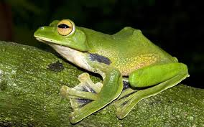
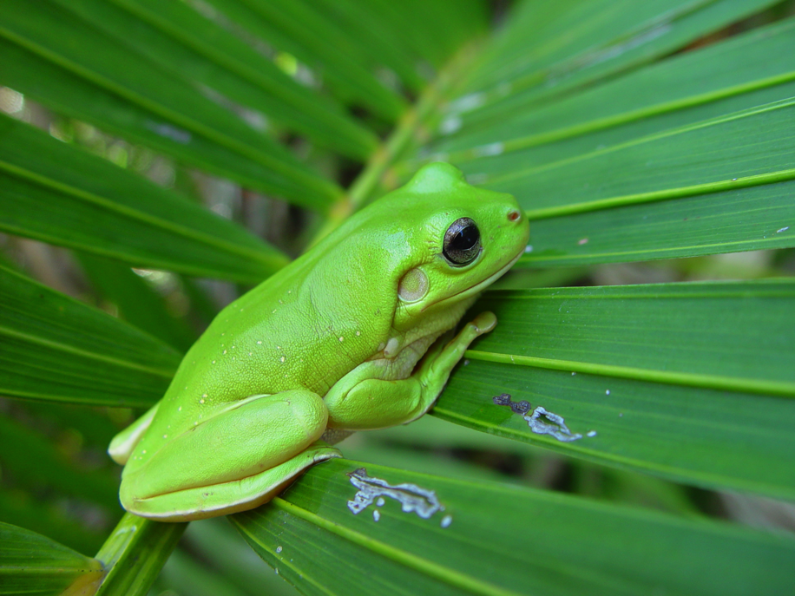
Frog Life Cycle: Adult Frog
Once the tail is gone, the froglets are adults!
The cycle will begin again when the adults lay eggs in a pond
www.telegraph.co.uk
http://simple.wikipedia.org/wiki/User:AJona1992/Frog
Notes:
Once the tail is gone, the froglets are adults! They will go about their froggy lives, catching food, living around swamps, ponds, and wetlands, and creating more eggs so that the cycle can start all over again.

Slide 10
Frog Life Cycle
Let’s name each stage!
Notes:
Let’s remember what we learned!
The stages are: Eggs (far left) to Tadpole to Froglet to Adult frog.

Slide 11
Frog Life Cycle
Let’s watch a video about what we just learned:
http://www.youtube.com/watch?v=pNkuj2Ftccg
Notes:
This video has sound, so make sure the volume is on!

